Slide 1
How to Identify and Report Illicit Discharges
GCSA Employee Training
Nienhuis Park Community Center
May 19, 2017
Richard Smith, Stormwater Consultant

Slide 2
Training About “Illicit Discharges”
40 CFR Part 122.26(b)(2) Illicit discharge means any discharge to a municipal separate storm sewer that is not composed entirely of storm water …
OKR04 Part IV.C.B.3(5) “Educate employees that have been working in the field, such as maintenance workers, building inspectors etc., to identify and report stormwater illicit discharges.” [Recommended]
This OKR04 recommended training is meant for field personnel, so this presentation is an overview.

Slide 3
Options for Training Field Personnel
MS4 Stormwater Manager holds in-house meetings with handouts, PowerPoints.
3rd Party videos (e.g., Excal, EPA-sourced, etc.).
3rd Party self-teaching modules.
In-house created videos, other media.
INCOG local training workshops at MS4.
Best if 30 min to 1 hour. Before work or brown-bag lunchtime sessions.
Simple, basic info, pictures, focus on fewer topics.

Slide 4
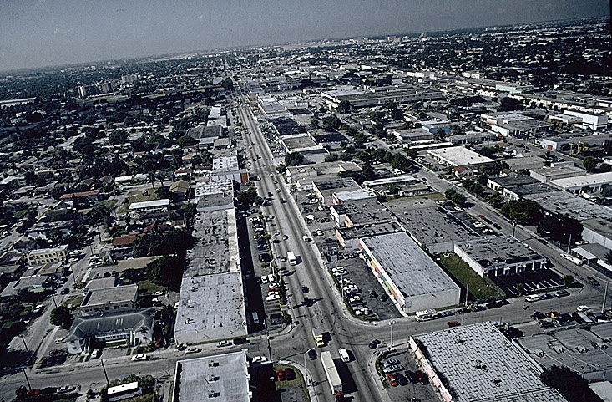
Range of Pollutants To Address
Sediment
Nutrients
Oxygen-Demanding Substances
Pathogens
Trash
Yard Waste
Road Salts
Oil and Grease
Heavy Metals
Heat
Petroleum
Pesticides
Other organics

Slide 5
MS4 Field Crews Needing Training
  Water, sewer, street department crews.
  Parks & recreation, grounds crews.
  Building inspectors and officials.
  Floodplain officials and managers.
  City engineers, city planners.
  Contractors on the job for MS4 projects.
  Utility meter reader crews.
  Police and Fire Departments (if they will be trained).

Slide 6
Types of Pollution Reporting
  How Pollution Might Be Reported by Third Parties:
    Citizen complaints, concerns (letters, email, phone).
    MS4 reporting hotline (email, phone).
    Local businesses, schools, clubs, organizations.
    Local, state or federal environmental agencies.
    News services, reporters.
    City councils, county commissions – agenda items.
    City contractors at outdoor projects.
  Have a formal system for logging pollution reports.

Slide 7
Types of Pollution Discovery (by the MS4)
  How Pollution Might Be Found by MS4 Personnel:
    Dry Weather Field Screen (DWFS) inspections.
    Other stormwater permit required inspections.
    Public works crews at job sites or en-route.
    Police and Fire Dept. on-scene observations.
    Parks & Recreation workers.
    City crews finding spills or releases.
    Construction site inspections.
  Have a formal system for tracking pollution responses.

Slide 8
Common Places To Find Pollution
  Construction sites, entry ways, storage areas.
  Drainage ditches, open channels, wooded creeks.
  Manholes away from traffic and people.
  Abandoned buildings and foundations.
  Dilapidated or partially demolished structures.
Isolated back lots of industrial areas.
Storage and loading/unloading areas at businesses.
Drop inlets; curb cuts from large surface areas in MS4.
Pipes and trickle channels into creeks.
Alleys and lots with dumpsters and trash bins.

Slide 9
Formal System for Tracking MS4 Actions
  MS4s must implement a program for “Illicit Discharge Detection and Elimination” (IDDE).
  Records must be kept of all actions taken regarding the IDDE program, and to report progress in the MS4’s Annual Report to ODEQ.
  OKR04 does not specify exactly how the local MS4 is to run their IDDE program; flexible but effective.
  Tracking System can be all electronic, all paper, or a combination of both.
  Tracking must cover A-Z (initial report to final actions).

Slide 10
Common Finds For Field Crews To Report
  Unexplained, suspicious flows in culverts, ditches, pipes.
  Unusual odors or discolored water or soil near creeks.
  Trash, debris, floating mats of algae or scum in creeks.
  Dead animals, batteries, containers or boxes in creeks.
Piles of discolored soils or dumped waste piles.
Fish kills or other signs of stressed or dead aquatic biota.
Log jams, piles of leaves or lawn clippings in creek.
Sediment or chemical runoff from construction sites.
Ground soaked with oil, paints, chemicals, solvents.

Slide 11
Problems With Identifying Pollution
  Most reports of Illicit Discharges (IDs) in your MS4 will involve unknown substances.
  Most IDDE field test kits will not detect specific chemicals.
  Look for labels on containers or property signs.
  Contact property owners or other suspected polluters.
  If you are uncertain about what the substance is, back off, protect area from others, and contact local HAZMAT.

Slide 12
First Step: Make a Visual Inspection
  Look for and (carefully and safely) investigate:
    Containers and labels;
    Sources such as batteries, cans, boxes, etc.
    Pipes, culverts, open channels with flow.
    Discolored water, soil, stains on concrete.
    Dead animals, dead vegetation.
    Floatables (trash, debris, vegetation, etc.).
  Note offensive or unusual odors (decay, sewage).
  Note water opacity (clarity) and color.

Slide 13
How Can You Identify What You Find?
  Many simple field test kits will look for characteristics, not specific chemicals.
    Dissolved oxygen, pH.
    Conductivity (salts, dissolved solids).
  Foremost is SAFETY. If the material is unknown, best to contact your local HAZMAT.
  Never attempt to access unknown substances without adequate training in handling hazardous materials.
  HAZMAT crews will have field kits, or lab analysis may be needed to get positive identification.

Slide 14
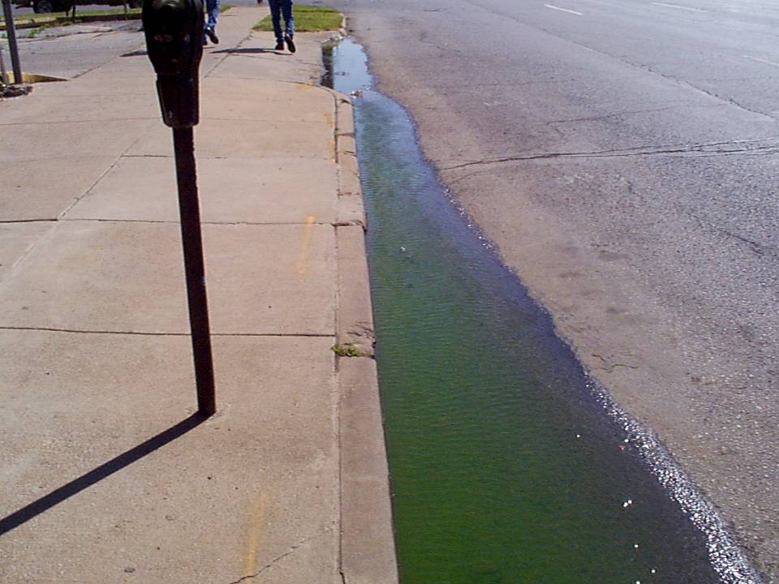

Pollution Reported: What Should You Do?
Can you find the source?
Is it toxic?
Who is in harm’s way?
City of Tulsa Photo.
Do you know where it is draining to?
Who is responsible for cleanup?

Slide 15
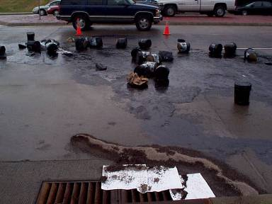
Another Example: Local Owner’s Efforts
What is it?
How do you determine the danger?
Who is responsible for cleanup?
Are owner’s containment BMPs adequate?
City of Tulsa Photo.

Slide 16
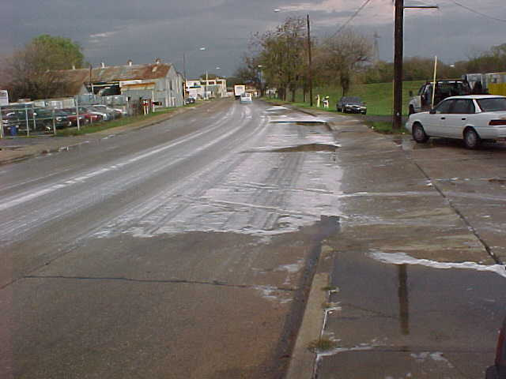
Another Example: What Do You Do?
City of Tulsa Photo.
What is it?
How do you determine the danger?
Should traffic be diverted?
If the MS4 must deploy HAZMAT (owner refuses or can’t clean up), do your local codes provide for cost recovery ?

Slide 17
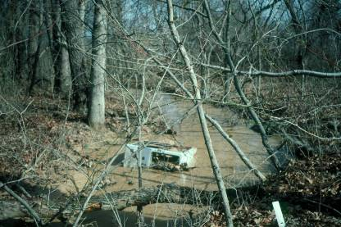
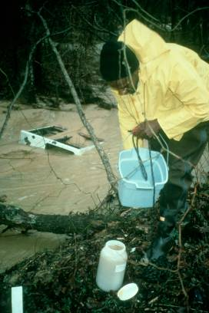
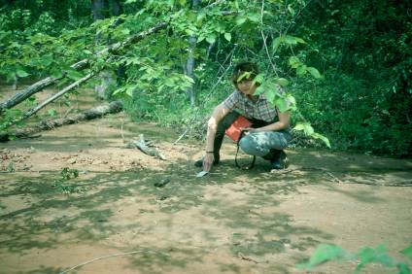
It Only Took 2 Months To Lose The Stream
Uncontrolled construction site erosion upstream.
OCC Photos.
Minor sediment loads can build quickly to large problems.

Slide 18
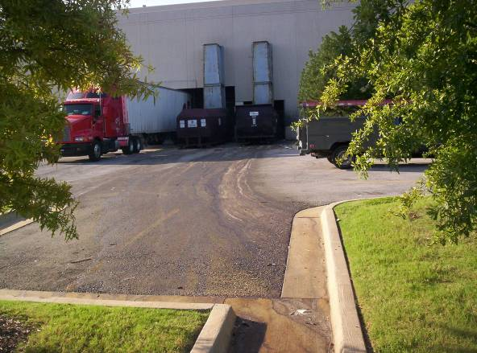
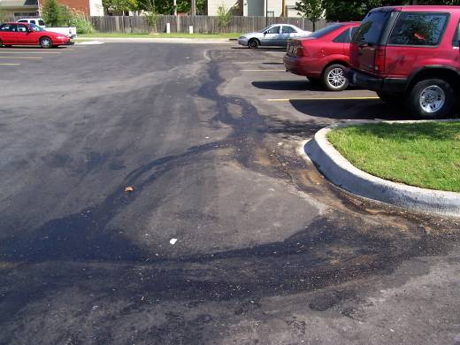
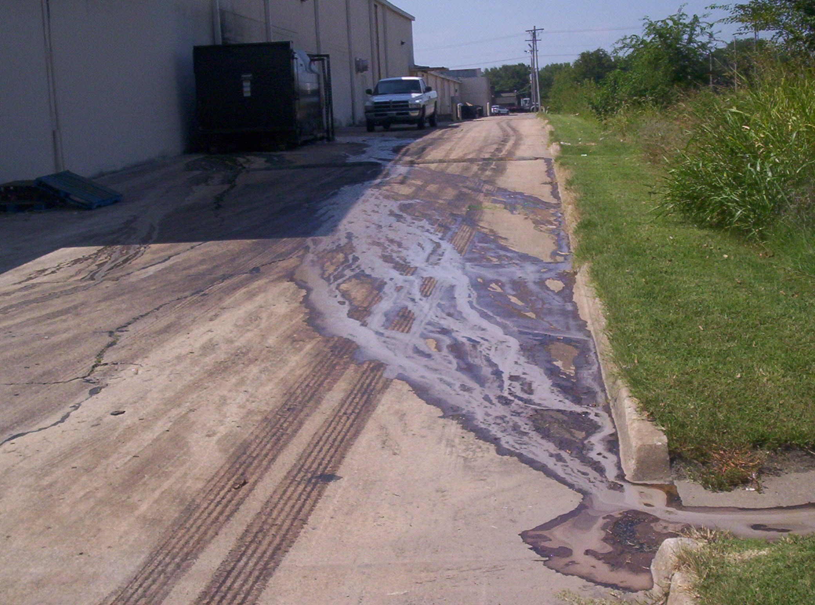
Is This Harmless “Dumpster Juice”?
City of Tulsa Photos.
Could this be toxic?
What are your inspection protocols?

Slide 19
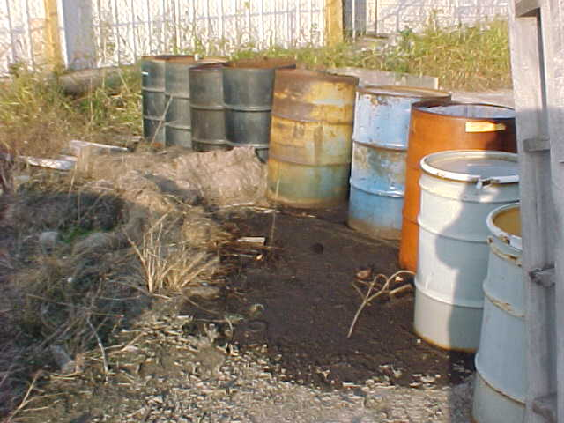
See Any Labels On These Barrels?
Do city crews have the training and safety gear to enter this property and begin an illicit discharge investigation?
If not, who do you contact?
City of Tulsa Photo.

Slide 20
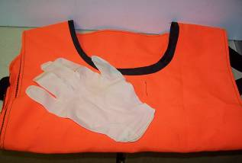
Personal Gear
Storm water field crews should be equipped, at a minimum, with the following gear:
Safety vests (reflective)
Proper footwear (boots, waders, safety shoes)
Personal flotation devices (PFD)
Gloves (rubber, leather)
Safety glasses, goggles or face shield
Emergency first aid kit

Slide 21





Questions ??
Vernon Seaman
Manager, Envir. And Energy Planning
INCOG
Two West 2nd Street, Ste 800
Tulsa, OK 74103
(918) 579-9451
vseaman@incog.org

